Slide 1
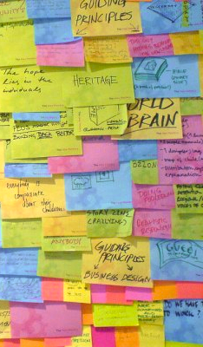
Brainstorming
CSCI 3002 Fall 2018

Slide 2
Updates
Recitation / first weekly activity
Feedback? Post it in Canvas chat
This week
Brainstorming & exploring solutions
The Deep Dive
Introduction to course project

Slide 3
Brainstorming
Why?
How?
Some practical tips

Slide 4
Against eureka-ism
In this “eureka” view, creativity is … something accessible only to persons of genius. It arises like a bolt of lightning, unanticipated, unpredictable and unanalyzable—but the bolts strike only a few special people. We ordinary mortals must stand in awe and thanks.
—Stephen Jay Gould, Darwin’s Middle Road
Notes:
A lot of times, creativity *feels* this way.

Slide 5
Making creativity happen
We can’t will our brains to come up with good ideas
So what can we do?
Give ourselves structure to focus on coming up with ideas
Catch ourselves before we quash potentially good ideas
Learn how to make faster/better decisions about our rough ideas

Slide 6
Why we might need help
Our brains act as cognitive misers*
They’re often drawn to the simplest solution that works (aka satisficing**)
Our design ideas can lead to hill-climbing, missing or ignoring problems
*Susan Fiske and Shelley Taylor (1984). Social Cognition.
**Herb Simon (1956). Psychological Review 63(2).

Slide 7
Brainstorming with rules
We can use rules and games to structure our brainstorming activities
May help us to give sufficient time to ideas, try things we might otherwise skip over
A key idea in this class is that it can be really difficult to fix a bad idea later
Notes:
You can learn this lesson through making mistakes (and you might anyway) … but it may help to hear it!
Spending more time at the idea stage can often help your work in the future, whereas charging ahead with a flawed idea can be really difficult to fix later.

Slide 8
Cardinal rules for brainstorming
Spend more time coming up with ideas than you think you need to
Even ideas you don’t pursue may be helpful in the future
Separate idea generation from idea evaluation
Give yourself room to generate ideas without worrying about their flaws

Slide 9
More rules for brainstorming
Before you start, agree on a topic for the brainstorming session; set a time limit
Focus on one conversation at a time
Aim for large quantity of ideas
“Headlining” – try to frame what’s unique about this idea in a simple sentence
Build on the ideas of others
In improv comedy, this is known as “hitting the ball back” or “yes, and”
Notes:
Rules are from https://dschool-old.stanford.edu/sandbox/groups/dstudio/wiki/2fced/attachments/660d8/Brainstorming-Method.pdf?sessionID=d07c198d92501ebb3eee4ff3da193b387130fcbf
We never want to say ”no” or “but” during the early stages of brainstorming. We can always go back and address these issues later.

Slide 10
Even more rules
Encourage wild ideas (you can modify them later)
Represent ideas visually
Stay on topic
Defer judgment of ideas; no “blocking”
Notes:
Rules are from https://dschool-old.stanford.edu/sandbox/groups/dstudio/wiki/2fced/attachments/660d8/Brainstorming-Method.pdf?sessionID=d07c198d92501ebb3eee4ff3da193b387130fcbf
Examples of blocking?
“That will never work because X”
“That will be too expensive / slow / etc”
”I don’t like it because Y”
“This conflicts with another idea we generated”

Slide 11
Rules 5-8
The Stanford School of Design has explored this topic extensively, and documented what works (in many cases)
Nice summary here

Slide 12
Brainstorming examples
What to do
What to avoid

Slide 13
Does brainstorming work?
Research has shown mixed results regarding the effectiveness of group brainstorming vs. generating ideas alone
Regardless, one key step is taking the time to think through all the possible ways to do something, rather than charging ahead with your first idea
Notes:
One good part of brainstorming in a group is that there might be social pressure to do this.

Slide 14
Where brainstorming fails
Move forward with an idea that has serious flaws (that will be painful to fix later)
Get “locked in” to an idea so much that it’s hard to even think of alternatives
Missing out on interesting ideas by thinking too narrowly
Convincing yourself that there is no solution, or no good solution

Slide 15
Seeing the design process in action
The Deep Dive, a TV news segment from 1999
Investigates design from IDEO, one of the best known design firms in the world
and an offshoot of the Stanford d.school
Watch the video here

Slide 16
Things to watch for
How are they coming up with ideas, and curating them?
Juicy quotes about IDEO’s process?
Where do they make mistakes or overlook things?
Where do they break their own rules?

Slide 17
Deep Dive comments
Allow clashing ideas
Set time bounds
Combining multiple ideas / zeroing in on problems
Talking to stakeholders. Users vs. stakeholders
Handling trade-offs
Diverse team / perspectives (backgrounds, skills)
“Fail fast to succeed sooner”, “Enlightened trial and error.”
Process is generalizable

Slide 18
More brainstorming tools

Slide 19
Brainstorming tools
Dealing with discomfort
Using constraints
Using mashups
Using games and activities

Slide 20
Discomfort as design tool 😖
In my experience, there are certain things we can do that will help with this process, but most people (especially engineers?) don’t want to do

Slide 21
Discomforting tasks
Sitting and waiting to think of ideas 😣
Sitting and waiting for more ideas after you have one 😫
Asking for feedback from others 😰
Going back and re-doing things based on that feedback 😴
Trying to find problems with your ideas so you can fix them 😱
Notes:
It’s not a judgment to say people don’t want to do these things. Who wants to re-do their work?
The trick here is to gain experience and see how these

Slide 22
Learning from others
RAZ: Well, you know, the thing that really helped make Instagram a huge success was a feature that Kevin decided to add, you know, almost by accident. And it happened when he was describing the app to his girlfriend, Nicole.
SYSTROM: I'm like, you know, Nicole, I think we're going to focus on photos. And she goes, I don't think I'm going to post that much. My photos aren't that good. They're not as good as your friend Greg. And I was like, well, Greg uses a bunch of filter apps to, like, make them look nice. And she goes, oh, you should probably add filters. And I was like, ah, that's it. Like, we just need to be able to make people feel like their photos are worthy of sharing.
—Guy Raz and Kevin Systrom, How I Built This
Notes:
From https://www.npr.org/2016/09/19/494538482/npr-podcast-how-i-built-this-instagram

Slide 23
Using constraints
In general, we often think of constraints as a bad thing
In this view, a design with lots of constraints is worse than a design that works everywhere
In engineering and CS we often seek solutions that handle all possible test cases
… but there are limitations to this approach

Slide 24
Constraints in design
Think of a brand new app
Now, think of an app for new mothers
Notes:
Constraining the problem space can help us think through our options.

Slide 25
Benefits of constraints
Can help us get unstuck
It’s often easier to come up with solutions to specific problems
More ideas to try
Fewer edge cases to derail our thinking

Slide 26
General vs. specific solutions
If we design for every possible user and usage scenario, we may end up with generic solutions
Search sites look like Google; stores look like Amazon
These solutions end up boring, with no need to even think about design
No opportunity to demonstrate your skills as a designer

Slide 27
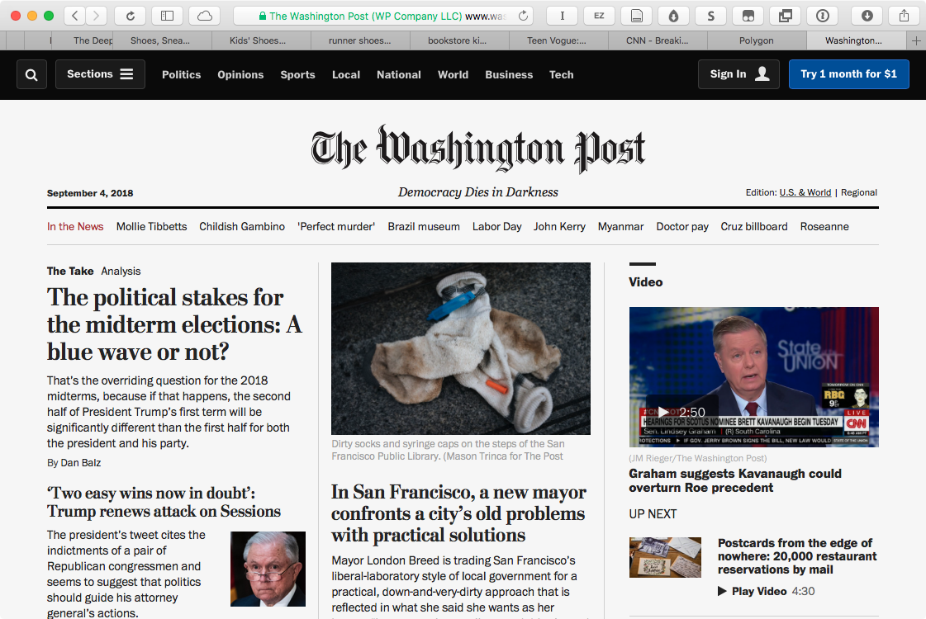
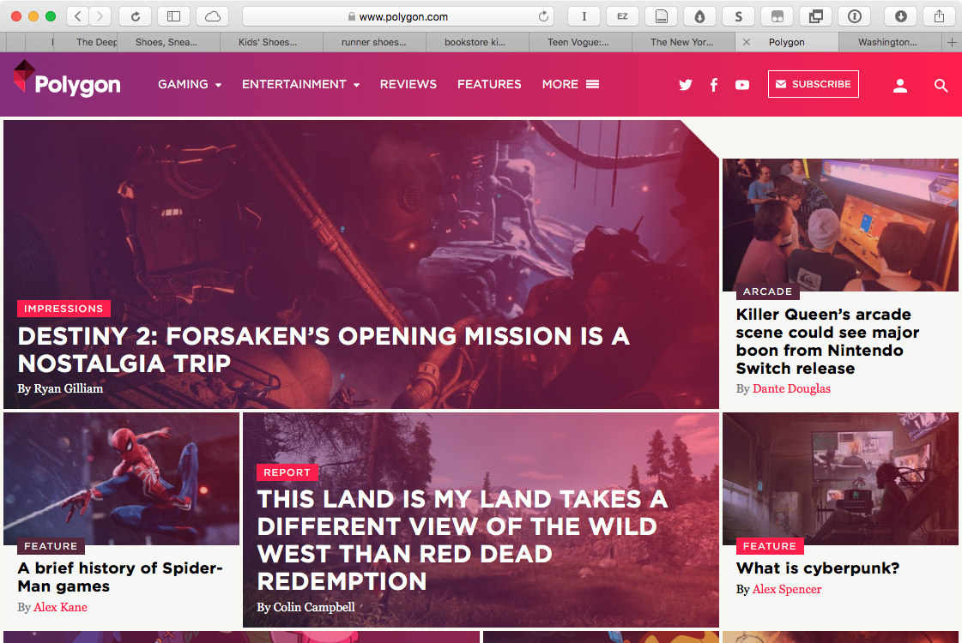
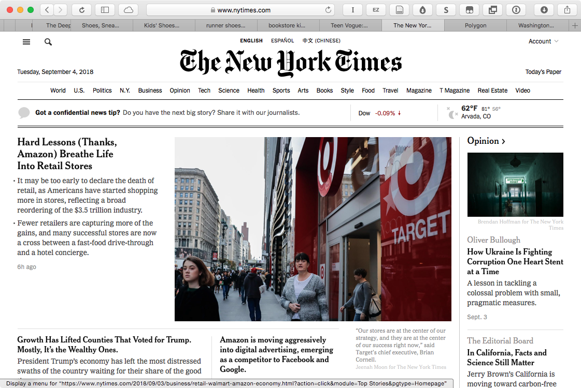
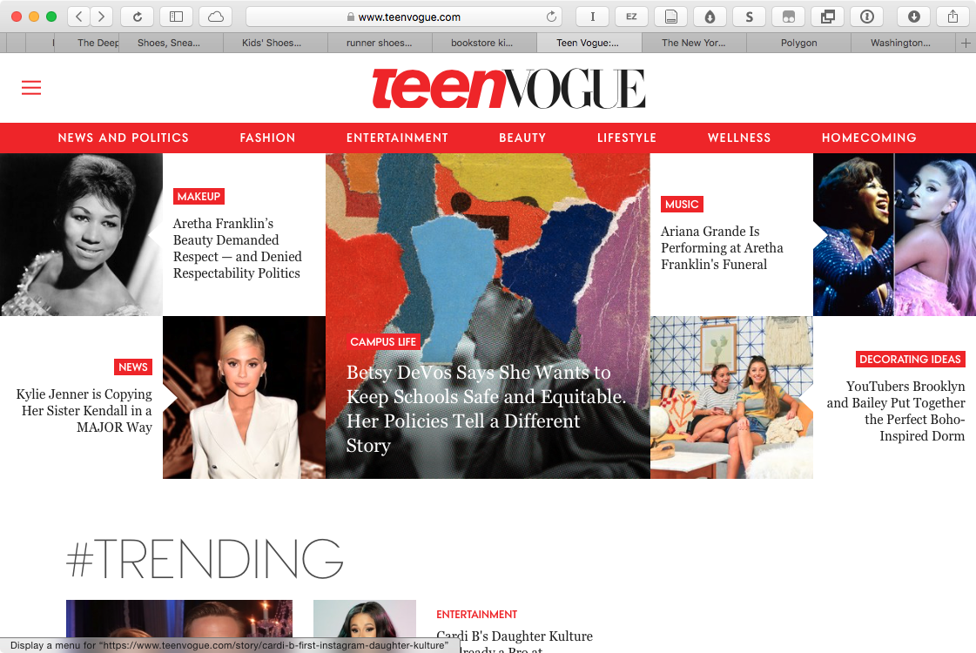
How specialization can help
Notes:
Sites: Washington Post, Polygon, Teen Vogue, New York Times
The two newspapers are generic and thus very same-y. The other sites have some identity.
We’ll come back to this example later.

Slide 28
More on specialization
What’s unique and creative about NYTimes?
What’s unique and creative about Teen Vogue?
Notes:
Teen Vogue: Colorful design, focus on women (especially youyng women), page categories reflect interests of their audience.

Slide 29
Mashups in design
Another way to explore ideas is to combine elements from existing ideas
Identify what is useful and interesting about one design, and bring it to a new context

Slide 30
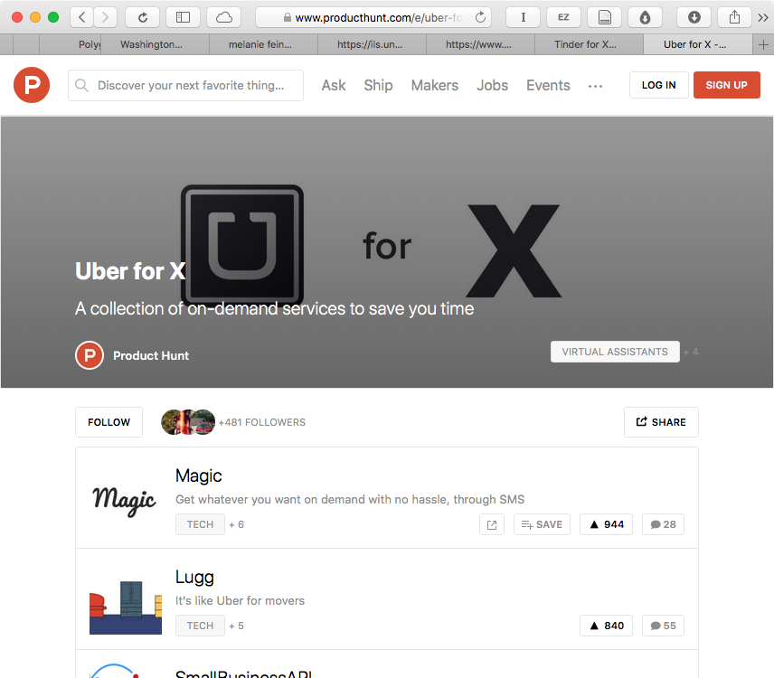
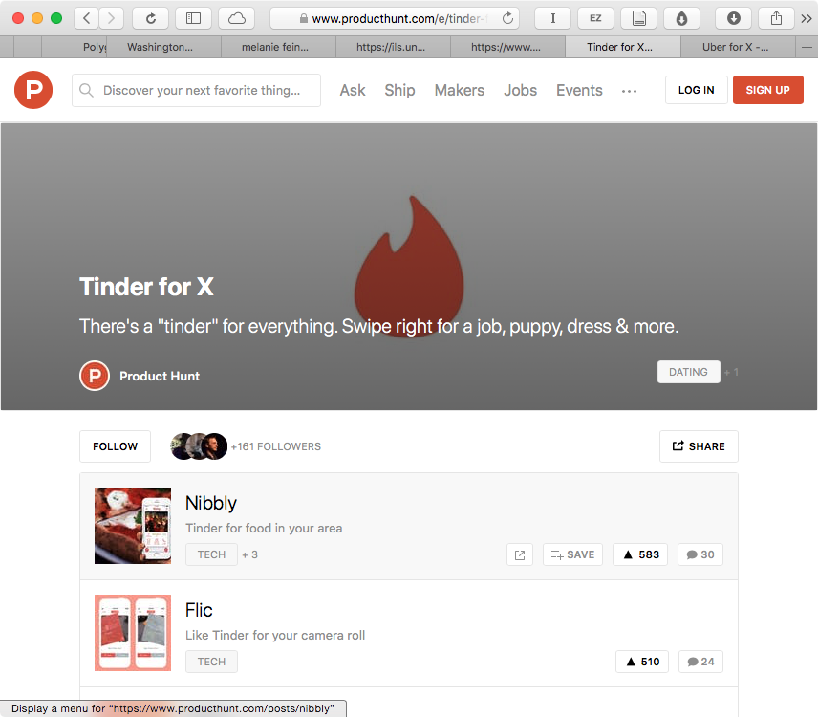
Notes:
Images from producthunt.com

Slide 31
Including randomness
We can even mash up totally random ideas and get something useful
The more ideas we add, the clearer the possible designs can be
Follow improv principle of “yes, and”
Incorporate all new ideas

Slide 32
Yes, And
A new mobile app for ________
Notes:
Yes, AND

Slide 33

Brainstorming Technique: Bootlegging
Brainstorming “mashups”
Process
Individual generation
Mixing categories
Brainstorming
Final idea
Lars Erik Holmquist (2008). Bootlegging: multidisciplinary brainstorming with cut-ups. PDC ‘08

Slide 34
Bootlegging Example: Everyday Robots
Categories
Type of robot (e.g. humanoid, wheeled robot, etc.)
Property of robot (e.g. autonomous behavior, collaboration with others, etc.)
Place or situation (e.g. in the kitchen, running, commuting to work, etc.)
User or user group (e.g. grandmothers, musicians, a secret agent, etc.)
Sample Outcomes
Type: Small flying robot
Property: Can perform face recognition
Place/situation: Plate
User: Dancer
Application idea: A flying plate at a discothèque offering drinks when it recognizes the face of customers
Type: Entertainment robot
Property: Wireless communication
Place/situation: Gym
User: Hyperactive kid
Application idea: A personal trainer or playmate for hyper-active children. The robot represents another friend some where else through wireless communication and lets the kids compete remotely

Slide 35
Let’s try bootlegging with sports wearables
What are some key variables?
Element 1 | Element 2 | Element 3 | Element 4

Slide 36
Why bootlegging works
Requires you to think through the possibilities, and generate some plausible options
Randomized solutions are specific enough to generate ideas for

Slide 37
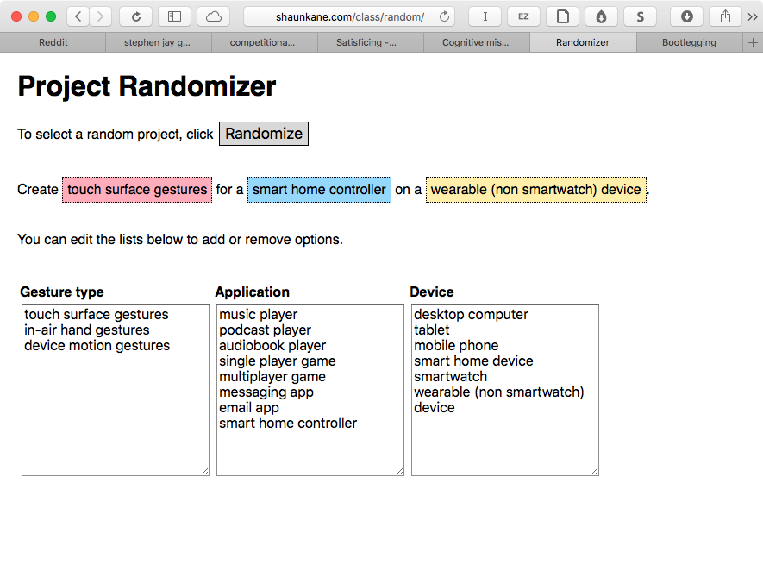
Automating the process
http://shaunkane.com/class/random/

Slide 38
Toolkits for generating ideas
IDEO Method Cards: introduce activities for exploring design problems
Oblique Strategies: introduce randomness to help you get unstuck

Slide 39
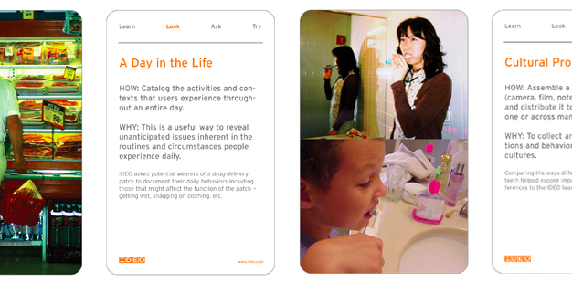
http://www.ideo.com/work/method-cards/

Slide 40
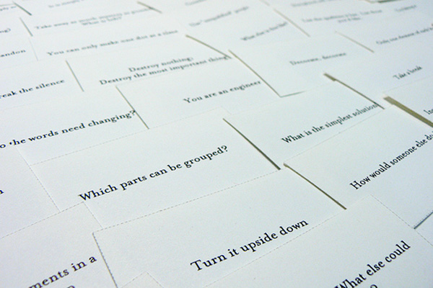
http://en.wikipedia.org/wiki/Oblique_Strategies
http://www.joshharrison.net/oblique-strategies/

Slide 41
Example: Oblique Strategies
Using online generator
Problem: Designing a restaurant search app
Notes:
Our brains are actually really good at taking seemingly random feedback and applying it to a problem we are trying to solve.

Slide 42
Final thoughts on creativity and brainstorming
It’s not an inherent personality trait
But practice helps
It helps to know common pitfalls and try to recognize when they are happening
Many opportunities to use structured activities and tools to help guide the process

Slide 43
Next time
More on brainstorming and creativity
Exploring possible class projects

